Slide 1

Welcome to my presentation
by Sourav saha
Roll: 14
Batch: 25

Slide 2
What is working capital management?
Why It is necessary ?
Why say working capital management is the life blood of company ?

Slide 3
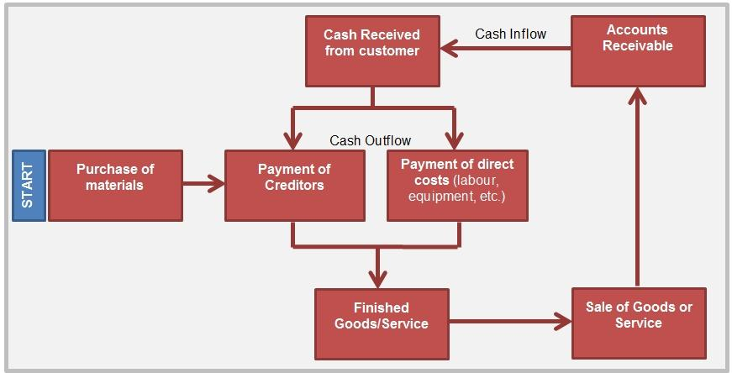
Life blood of the firm

Slide 4
Chapter 4
Cash Forecasting
Cash forecasting is the process of predicting a company's future cash inflows and outflows over a specific period.

Slide 5
Cash forecasting
Key components
Historical Data Analysis
Revenue Projections
Expense Forecasting
Working Capital Management
Cash Reserves and Financing
Methods
Direct Method
indirect Method
Rolling method
Scenario Planning

Slide 6
Chapter: 5 Models for the management of cash and temporary investment
Management of cash :
The process of collecting, managing, and investing cash flows to ensure sufficient liquidity for operational needs.
Importance: Anticipates cash inflows and outflows, allowing for better planning and management.
Techniques: Historical data analysis, trend analysis, and consideration of seasonal variations.

Slide 7
What is credit granting decision
Credit granting decisions refer to the process by which a business evaluates and decides whether to extend credit to customers.

Slide 8
Chapter - 5
The Firms Level of Aggregate Liquidity
Current Assets
Current Liability
Current ratio
Quick ratio

Slide 9
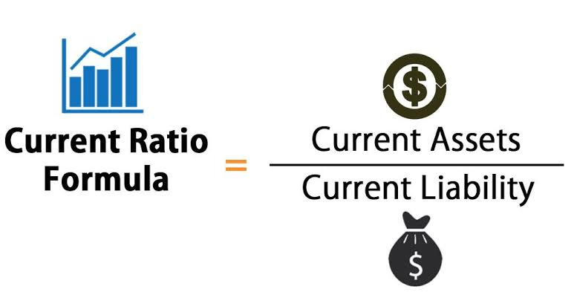
Current Ratio
What Is the Current Ratio?
The current ratio is a liquidity ratio that measures a company’s ability to pay short-term obligations or those due within one year.

Slide 10
Year | 2012-2013 | 2013-2014 | 2014-2015 | 2015-2016 | 2016-2017 | 2017-2018 | 2018-2019 | 2019-2020 | 2020-2021 | 2021-2022
Apex’s Current Ratio | 1.06 | 1.02 | 0.21 | 1.59 | 0.96 | 0.95 | 0.97 | 1.00 | 1.04 | 1.06
Bata’s Current Ratio | 2.61 | 2.6 | 1.96 | 2.48 | 2.74 | 2.76 | 2.92 | 2.51 | 5.84 | 2.44
Apex
Bata

Slide 11
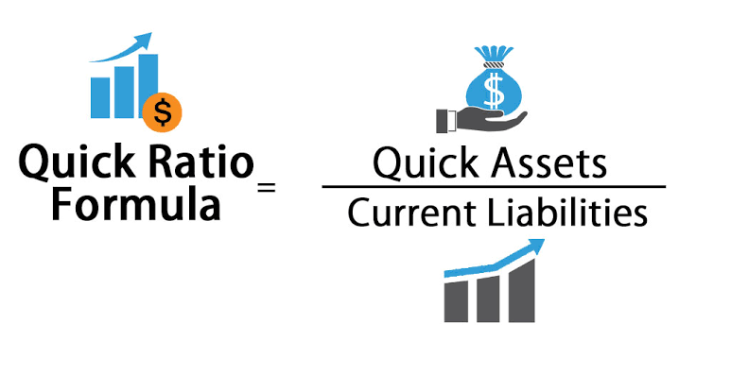
Quick Ratio
What Is the Quick Ratio?
The quick ratio is an indicator of a company’s short-term liquidity position and measures a company’s ability to meet its short-term obligations with its most liquid assets.

Slide 12
Year | 2012-2013 | 2013-2014 | 2014-2015 | 2015-2016 | 2016-2017 | 2017-2018 | 2018-2019 | 2019-2020 | 2020-2021 | 2021-2022
Apex’s Quick Ratio | 0.88 | 0.47 | 0.11 | 1.49 | 0.34 | 0.29 | 0.89 | 0.92 | 0.96 | 0.98
Bata’s Quick Ratio | 1.51 | 1.61 | .60 | 1.00 | 1.31 | 2.24 | 1.59 | 1.41 | 3.93 | 1.37
Apex
Bata

Slide 13
FIXED ASSETS TURNOVER
Fixed asset turnover is the ratio of net sales divided by net fixed assets.
This ratio is one of the efficiency ratios used by analysts to determine the overall effective utilization of the resources by a company.
It is expressed as:
Formula= 𝑁𝑒𝑡 𝑆𝑎𝑙𝑒𝑠 ÷ 𝐹𝑖𝑥𝑒𝑑 𝐴𝑠𝑠𝑒t

Slide 14
Analysis of Apex company
Here 2012-2013: The ratio is 4 times, indicating the company generated $4 in sales for every dollar of fixed assets. This shows efficient use of fixed assets. 2013-2014:A sharp decline to 0.58 times indicate a serious issue, where sales generated from fixed assets fell dramatically, likely due to market challenges or over investment. 2021-2022: A recovery to 3.66 times suggest improved efficiency in asset utilization, but it is still below the peak levels seen in 2018-2019.

Slide 15
Analysis of Bata company
2012-2013: The Fixed Assets Turnover ratio is 3.1, indicating that the company generated $3.10 in sales for every dollar invested in fixed assets. This shows a reasonable level of efficiency. A recovery to 2.2 indicates some improvement, but it’s still far from the higher efficiency levels seen earlier in the decade.

Slide 16
NET LIQUID BALANCE RATIO
This index measure center on the firm’s balance of cash and marketable securities. The argument is that this balance represents the firm’s true reserve against unanticipated cash needs, since other remedies for cash shortages can be very costly.
Formula= 𝐶𝑎𝑠ℎ+𝑀𝑎𝑟𝑘𝑒𝑡𝑎𝑏𝑙𝑒 𝑆𝑒𝑐𝑢𝑟𝑖𝑡𝑦−𝑁𝑜𝑡𝑒𝑠 𝑃𝑎𝑦𝑎𝑏𝑙𝑒 𝑇𝑜𝑡𝑎𝑙 𝐴𝑠𝑠𝑒𝑡 ÷ Total Assets

Slide 17
Analysis of Apex company
In 2012-2013, the rate was 0.36, indicating a reasonably healthy liquidity position. However, this dropped sharply to 0.01 in 2013-2014, suggesting significant liquidity issues where net liquid assets were nearly insufficient to cover liabilities. A slight recovery occurred in 2014-2015 with the rate rising to 0.19, and it continued to improve to 0.22 in 2015-2016. The rate stabilized at 0.31 in both 2016-2017 and 2017-2018, indicating a better balance between liquid assets and liabilities.

Slide 18
Analysis of Bata company
In 2013 and 2014, the Net Liquid Balance ratio are 0.039, 0.069, 0.09, 0.02, and 0.02. These are low for the company to meet its liquidity. But in the next three years, the ratios are increasing gradually and these are 0.09, 0.02 and 0.02 as cash is increasing in proportion to total assets.

Slide 19
ACCOUNTS RECEIVABLE TURNOVER:
The accounts receivable turnover ratio measures a company's effectiveness in collecting its receivables or money owed by clients. The ratio shows how well a company uses and manages the credit it extends to customers and how quickly it is collected or being paid.

Slide 20
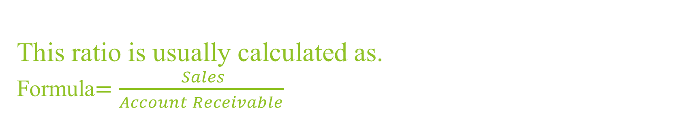
This ratio is usually calculated as. Formula$=\frac{ Sales}{Account Receivable}$
Now let’s see “Apex Ltd” 10 years. Account Receivable Turnover
Years | 2012-2013 | 2013-2014 | 2014-2015 | 2015-2016 | 2016-2017 | 2017-2018 | 2018-2019 | 2019-2020 | 2020-2021 | 2021-2022
Accounts Receivables Turnover | 37 | 50 | 13 | 14 | 14 | 19 | 7 | 12 | 13 | 10

Slide 21
Now let’s see “Bata Ltd” 10 years. Account Receivable Turnove.
Years | 2012-2013 | 2013-2014 | 2014-2015 | 2015-2016 | 2016-2017 | 2017-2018 | 2018-2019 | 2019-2020 | 2020-2021 | 2021-2022
Sales | 21298 | 27808 | 24753 | 25438 | 26872 | 29970 | 31223 | 18013 | 24436 | 34889
Accounts Receivables Turnover | 27 | 37 | 42 | 37 | 40 | 34 | 48 | 29 | 31 | 49

Slide 22
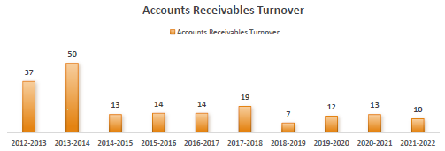
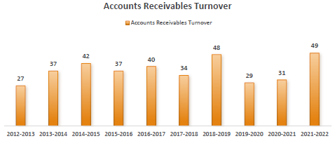
Comparison of Apex and Bata Ltd.

Slide 23
INVENTORY TURNOVER:
Inventory turnover is a ratio showing how many times a company has sold and replaced inventory during a given period. It measures the activity, or liquidity of a firm's inventory. The higher the turnover, the more liquid the asset.
Formula = 𝐶𝑜𝑠𝑡 𝑜𝑓 𝐺𝑜𝑜𝑑 𝑠𝑜𝑙𝑑 /𝐼𝑛𝑣𝑒𝑛𝑡𝑜𝑟𝑦

Slide 24
Now let’s see “Apex Ltd” 10 years. Inventory Turnover

Slide 25
INVENTORY COLLECTION PERIOD:
Inventory collection period is a financial metric that measures the average number of days it takes a company to collect payment from its customers for inventory that has been sold.
Formula=360/𝐼𝑛𝑣𝑒𝑛𝑡𝑜𝑟𝑦 𝑇𝑢𝑟𝑛𝑜𝑣𝑒𝑟

Slide 26
Comparison of Bata and Apex Ltd

Slide 27
AVERAGE COLLECTION PERIOD
The average collection period (ACP) is a financial metric that measures the average number of days it takes a company to collect payment from its customers for credit sales.
For a manufacturing company, an ideal average collection period typically ranges from 30 to 60 days. a shorter average collection period is often considered better because it indicates that a company is collecting payments from its customers more quickly. This can lead to improve cash flow and financial stability.

Slide 28
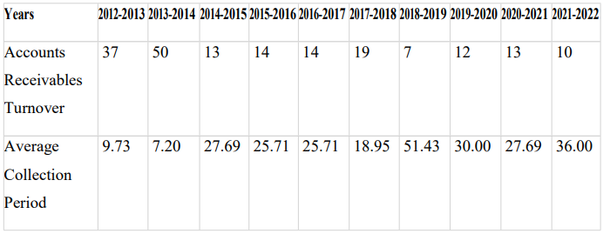
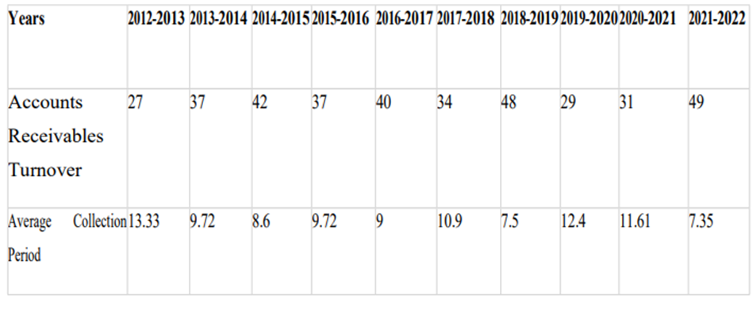
Now let’s see “Apex Ltd” 10 years. Average collection period.
And let’s see “Bata Ltd” 10 years. Average

Slide 29
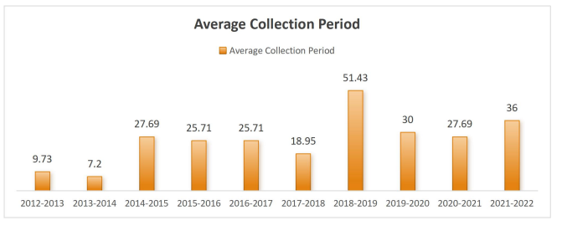
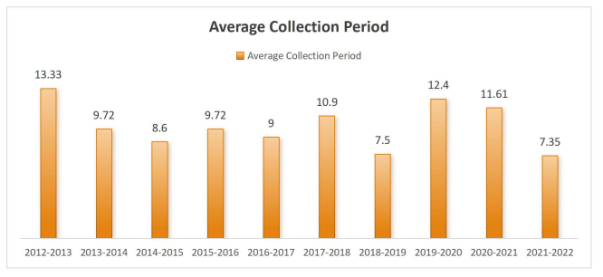
The Graph of Average Collection period of Apex Ltd.
The Graph of Average Collection period of Bata Ltd.

Slide 30
CASH CONVERSION
The cash conversion cycle (CCC) measures how quickly a company can convert its investments in inventory and other resources into cash flow from sales.
For a manufacturing company, a preferable cash conversion cycle (CCC) typically falls between 30 to 90 days. A shorter CCC indicates efficient management of inventory, receivables, and payables, allowing for quicker cash flow.
Formula: ( Average collection Period + Inventory Conversion Period ) – Payment Dafferal Period.

Slide 31
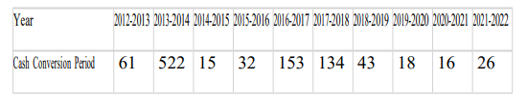
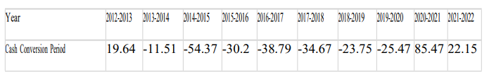
Now let’s see “Apex Ltd” 10 years. Cash Conversion Cycle.
And let’s see “Apex Ltd” 10 years. Cash Conversion Cycle.

Slide 32
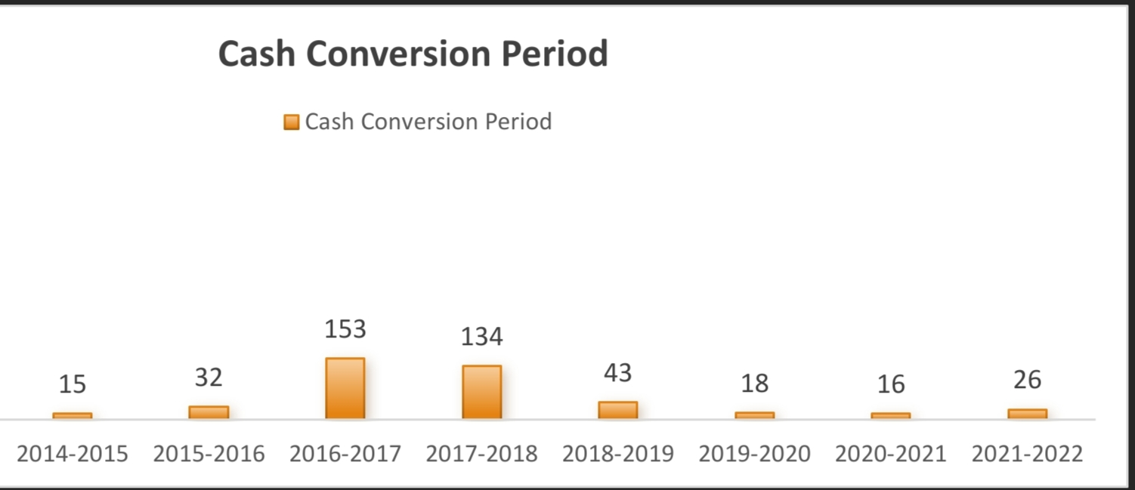
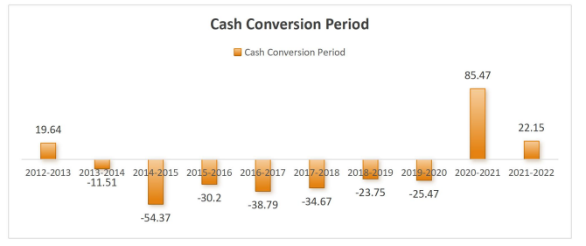
The Graph of cash conversion cycle of Apex Ltd.
The Graph of cash conversion cycle of Bata Ltd.

Slide 33
Comprehensive liquidity Index
The comprehensive liquidity index assesses a company's overall liquidity position by considering various factors, including current assets, quick assets, cash reserves, and the company’s ability to meet short-term obligations.
A higher index indicates better liquidity, suggesting that the company can easily cover its liabilities. Conversely, a lower index may signal potential liquidity issues, indicating challenges in meeting obligations without relying.

Slide 34
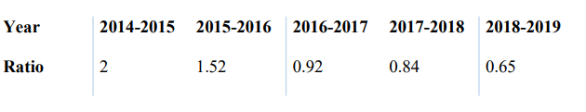
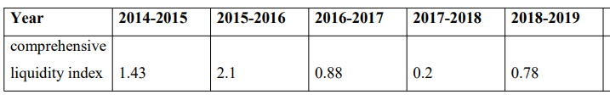
Now let’s see “Apex Ltd” 10 years. Comprehensive liquidity index.
Now let’s see “Bata Ltd” 10 years. Comprehensive liquidity index.

Slide 35
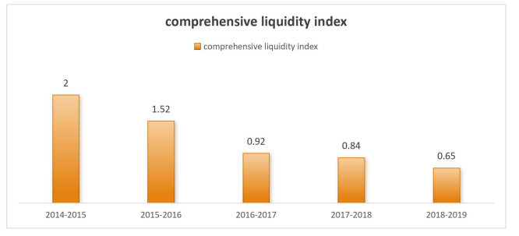
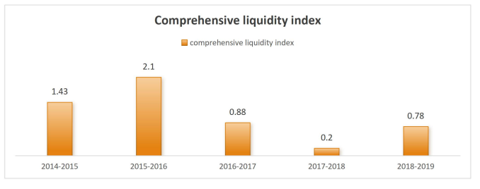
The Graph of Comprehensive Liquidity Index of Apex Ltd.
The Graph of Comprehensive Liquidity Index of Bata Ltd.

Slide 36
The End
Thank you.

